Slide 1


Slide 2
VLSI Technology Overview
Introduction
Very Large Scale Integration (VLSI) is the process of integrating millions or even billions of transistors onto a single silicon chip to implement complex electronic systems. Modern electronic devices such as smartphones, laptops, smart televisions, medical equipment, automotive controllers, and artificial intelligence (AI) processors are all built using VLSI technology.
VLSI has transformed electronics by enabling higher functionality, lower power consumption, reduced cost, and smaller device size.
The foundation of VLSI lies in semiconductor technology, particularly CMOS (Complementary Metal-Oxide-Semiconductor), which provides high-speed operation with very low power dissipation. Continuous advancements in fabrication technology have allowed transistor sizes to shrink from micrometers to nanometers, enabling more devices to be integrated on a single chip.
Modern semiconductor fabrication uses advanced technology nodes such as 28 nm, 14 nm, 7 nm, 5 nm, and 3 nm.

Slide 3
Objectives of VLSI
Increase the number of transistors on a chip.
Improve operating speed.
Reduce power consumption.
Minimize chip area.
Lower manufacturing cost.
Enhance system reliability.
Characteristics of VLSI
High integration density
High processing speed
Low power consumption
Compact size
High reliability
Low manufacturing cost
Advantages
Compact size
Low power
High performance
High reliability
Low production cost
Supports complex digital systems
Challenges
Process variations
Power dissipation
Heat management
Signal integrity
Verification complexity
Manufacturing cos

Slide 4
The Design Process
Creating a VLSI chip involves turning ideas into physical hardware using specialized software. The main steps include:
Coding: Engineers write code (using languages like Verilog or VHDL) to tell the chip what to do.
Simulation: Software tests the code to make sure there are no bugs.
Layout: Engineers draw the physical placement of transistors on the silicon.
Fabrication: The final design is printed onto a silicon wafer in a highly precise factory.
Real-World Uses
VLSI technology is the foundation of modern technology. Common examples include:
1. Mobile Phones: Chips process data quickly for 5G and mobile games.
2. Automotive: Chips run safety features and the dashboard.
3. AI and Computers: Chips perform complex tasks like training AI models.
4. Smart Home Devices: Chips control small gadgets while saving battery.

Slide 5
Intellectual Property (IP)
Intellectual Property (IP) blocks are reusable building blocks in modern chip design. Instead of building a whole chip from scratch, engineers combine these pre-made IP cores (like Lego blocks) to build a System-on-Chip (SoC).
A subsystem is a smaller, pre-verified cluster of IPs grouped to perform one specific job.
Why We Use IP Subsystems
Building a modern chip is incredibly complex. Engineers use pre-tested IP subsystems to save time. Instead of spending months figuring out complex rules like USB or PCI standards, companies buy a ready-made subsystem from a company like Synopsys. This lets engineers focus on their own unique ideas instead of reinventing basic parts.
Testing and Verification
Before combining all the IP subsystems into a final chip, engineers must test them.
IP Verification: Testing a single module to ensure it acts as it should.
Subsystem Verification: Testing a whole group of IPs together to ensure they talk to each other correctly.
The Future: Chiplets
Modern chips are hitting size limits. Instead of building one massive chip, engineers are now breaking the chip into smaller, modular "chiplets." This allows a company to place different IP subsystems onto separate, tiny chips and package them together.

Slide 6
IP (Intellectual Property) verification is a critical process in semiconductor and System-on-Chip (SoC) design that ensures pre-designed IP blocks, such as processor cores, memory units, communication interfaces, and hardware accelerators, function correctly before integration into a larger system.
The process primarily involves functional verification, where engineers use testbenches, checkers, and test cases to validate the IP under different operating conditions. It also includes corner-case and stress testing to identify and resolve potential issues.
Effective IP verification improves the reliability, functionality, and overall quality of the final chip design.

Slide 7
Subsystem Verification
Subsystem verification ensures that individual subsystems, such as GPUs, memory controllers, and communication interfaces, function correctly and integrate seamlessly within a larger electronic system.
It includes functional verification to validate subsystem behavior, performance validation to assess speed, power, and efficiency, and compatibility testing to ensure proper interaction with other modules.
Engineers also perform corner-case testing to verify robustness under extreme conditions and integration testing to confirm smooth communication and operation within the complete system.
This process helps ensure reliable and efficient system performance.

Slide 8
What is System on Chip (SoC) in VLSI?
A System on Chip (SoC) is a type of integrated circuit (IC) that integrates all the components of a computer or other electronic system into a single chip.
In the field of Very Large Scale Integration (VLSI), SoCs are used to design and manufacture complex electronic systems with a high degree of integration and functionality.
SoCs are a key component of modern electronics and are found in a wide range of devices, including smartphones, laptops, tablets, and many other types of electronic devices.
They are used to integrate a variety of functions, including processing, memory, communication, and input/output (I/O) onto a single chip, which reduces the size, cost, and power consumption of the system.
In VLSI design, SoCs are typically designed using a combination of hardware and software components, including processors, memory, I/O interfaces, and other peripherals.
These components are integrated onto a single chip using a combination of standard cell-based design and custom layout techniques.

Slide 9
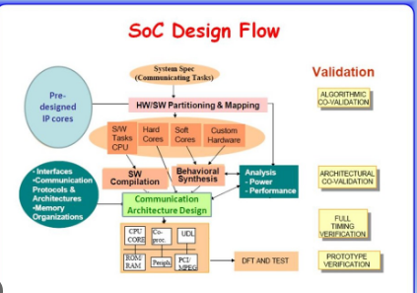

Slide 10
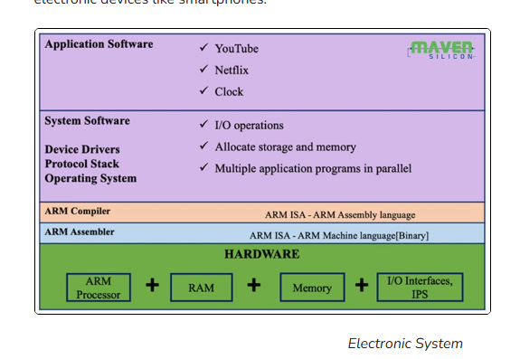
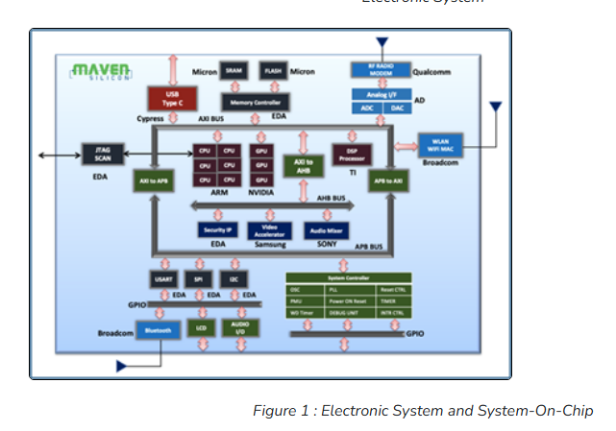
System on Chip
Electronic System & SoC
Electronic System

Slide 11
IP Verification
IPs are the fundamental building blocks for any SoC. So IP verification demands exhaustive white-box verification that demands methodologies like formal verification and random simulation, especially for the processor IPs as everything is initiated and driven by them as a central component in any SoCs.
Figure shows how we verify a processor IP using an exhaustive random simulation by a SystemVerilog-based UVM TB.
All the processor instructions can be simulated with various random values, generating functional, assertion, and code coverage.
We use coverage to measure the progress and quality of the verification and then for the final verification sign-off.
IP level verification demands good expertise in HVL programming, Formal and Dynamic ABV, Simulation debugging, and using VIPs and EDA tools.

Slide 12
Sub-System Verification
Sub-systems are composed of mostly pre-verified IPs and some newly built IPs like bridges and system controllers that are specific to the chip.
Figure 2 shows how we build an SoC from a sub-system that integrates all the necessary interface IPs, bridges, and system controllers using an on-chip bus like AMBA.
In this case, we prefer simulation-based Gray-box verification, especially random simulation using verification IPs. All the VIPs like AXI, AHB, APB, GPIO, UART, SPI, and I2C UVCs [UVM Verification Component] will be configured and connected with the respective interfaces.
As shown in the figure-2 , we create other TB components like reference models, scoreboards, and UVM RAL for making the verification environment self-checking.
We execute various VIP UVM sequences at the top level, verify the data flow, and measure the performance of the bus.

Slide 13
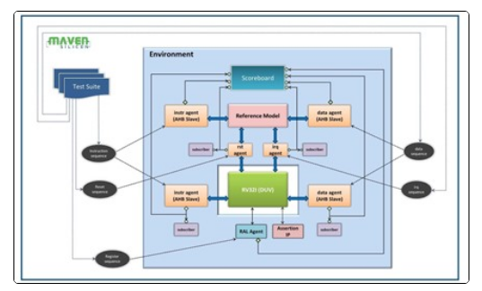
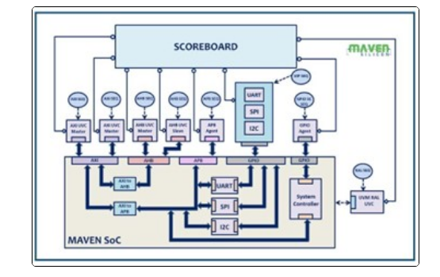
IP Verification Figure 1
Sub system Verification Figure 2

Slide 14
SoC Verification
SoCs are composed of primarily pre-verified third-party IPs and some in-house IPs.
Usually, we prefer a black-box verification using hardware emulation or simulation technologies for the SoC level verification. For example, you may come across a complex SoC verification environment, as shown in figure 3 .
The SoC testbench [TB] will have all kinds of testbench components like standard UVM Verification IPs[USB/Bluetooth/WiFi and standard interfaces], legacy HDL TB components [JTAG Agent] with UVM wrappers, custom UVM agents[Firmware agents], and some monitors, in addition to the scoreboard and SystemC/C/C++ functional models. In this case, you will have to deal with both firmware and UVM sequences at the chip level.
As a verification engineer, you need to know how to implement this kind of hybrid verification environment using the standard VIPs, legacy HDL BFMs and firmware code, and more importantly, how to automate the simulation/emulation using EDA tools.

Slide 15
SoC Verification

Slide 16
SoC Advantages:
Compact size
Low power consumption
Cost-effectiveness
Improved performance
Flexibility
Reliability
Integration of advanced features

Slide 17
